Slide 1
EIT x Soft Robots: project update
Week of Monday 19/04/2021

Slide 2
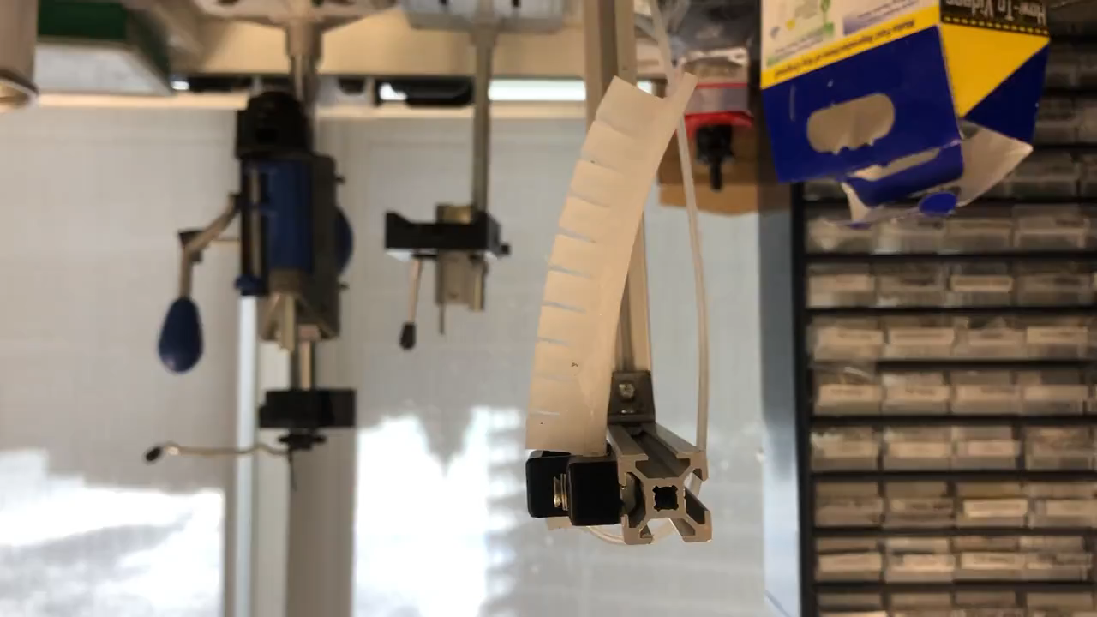
Functioning PneuNet actuator

Slide 3
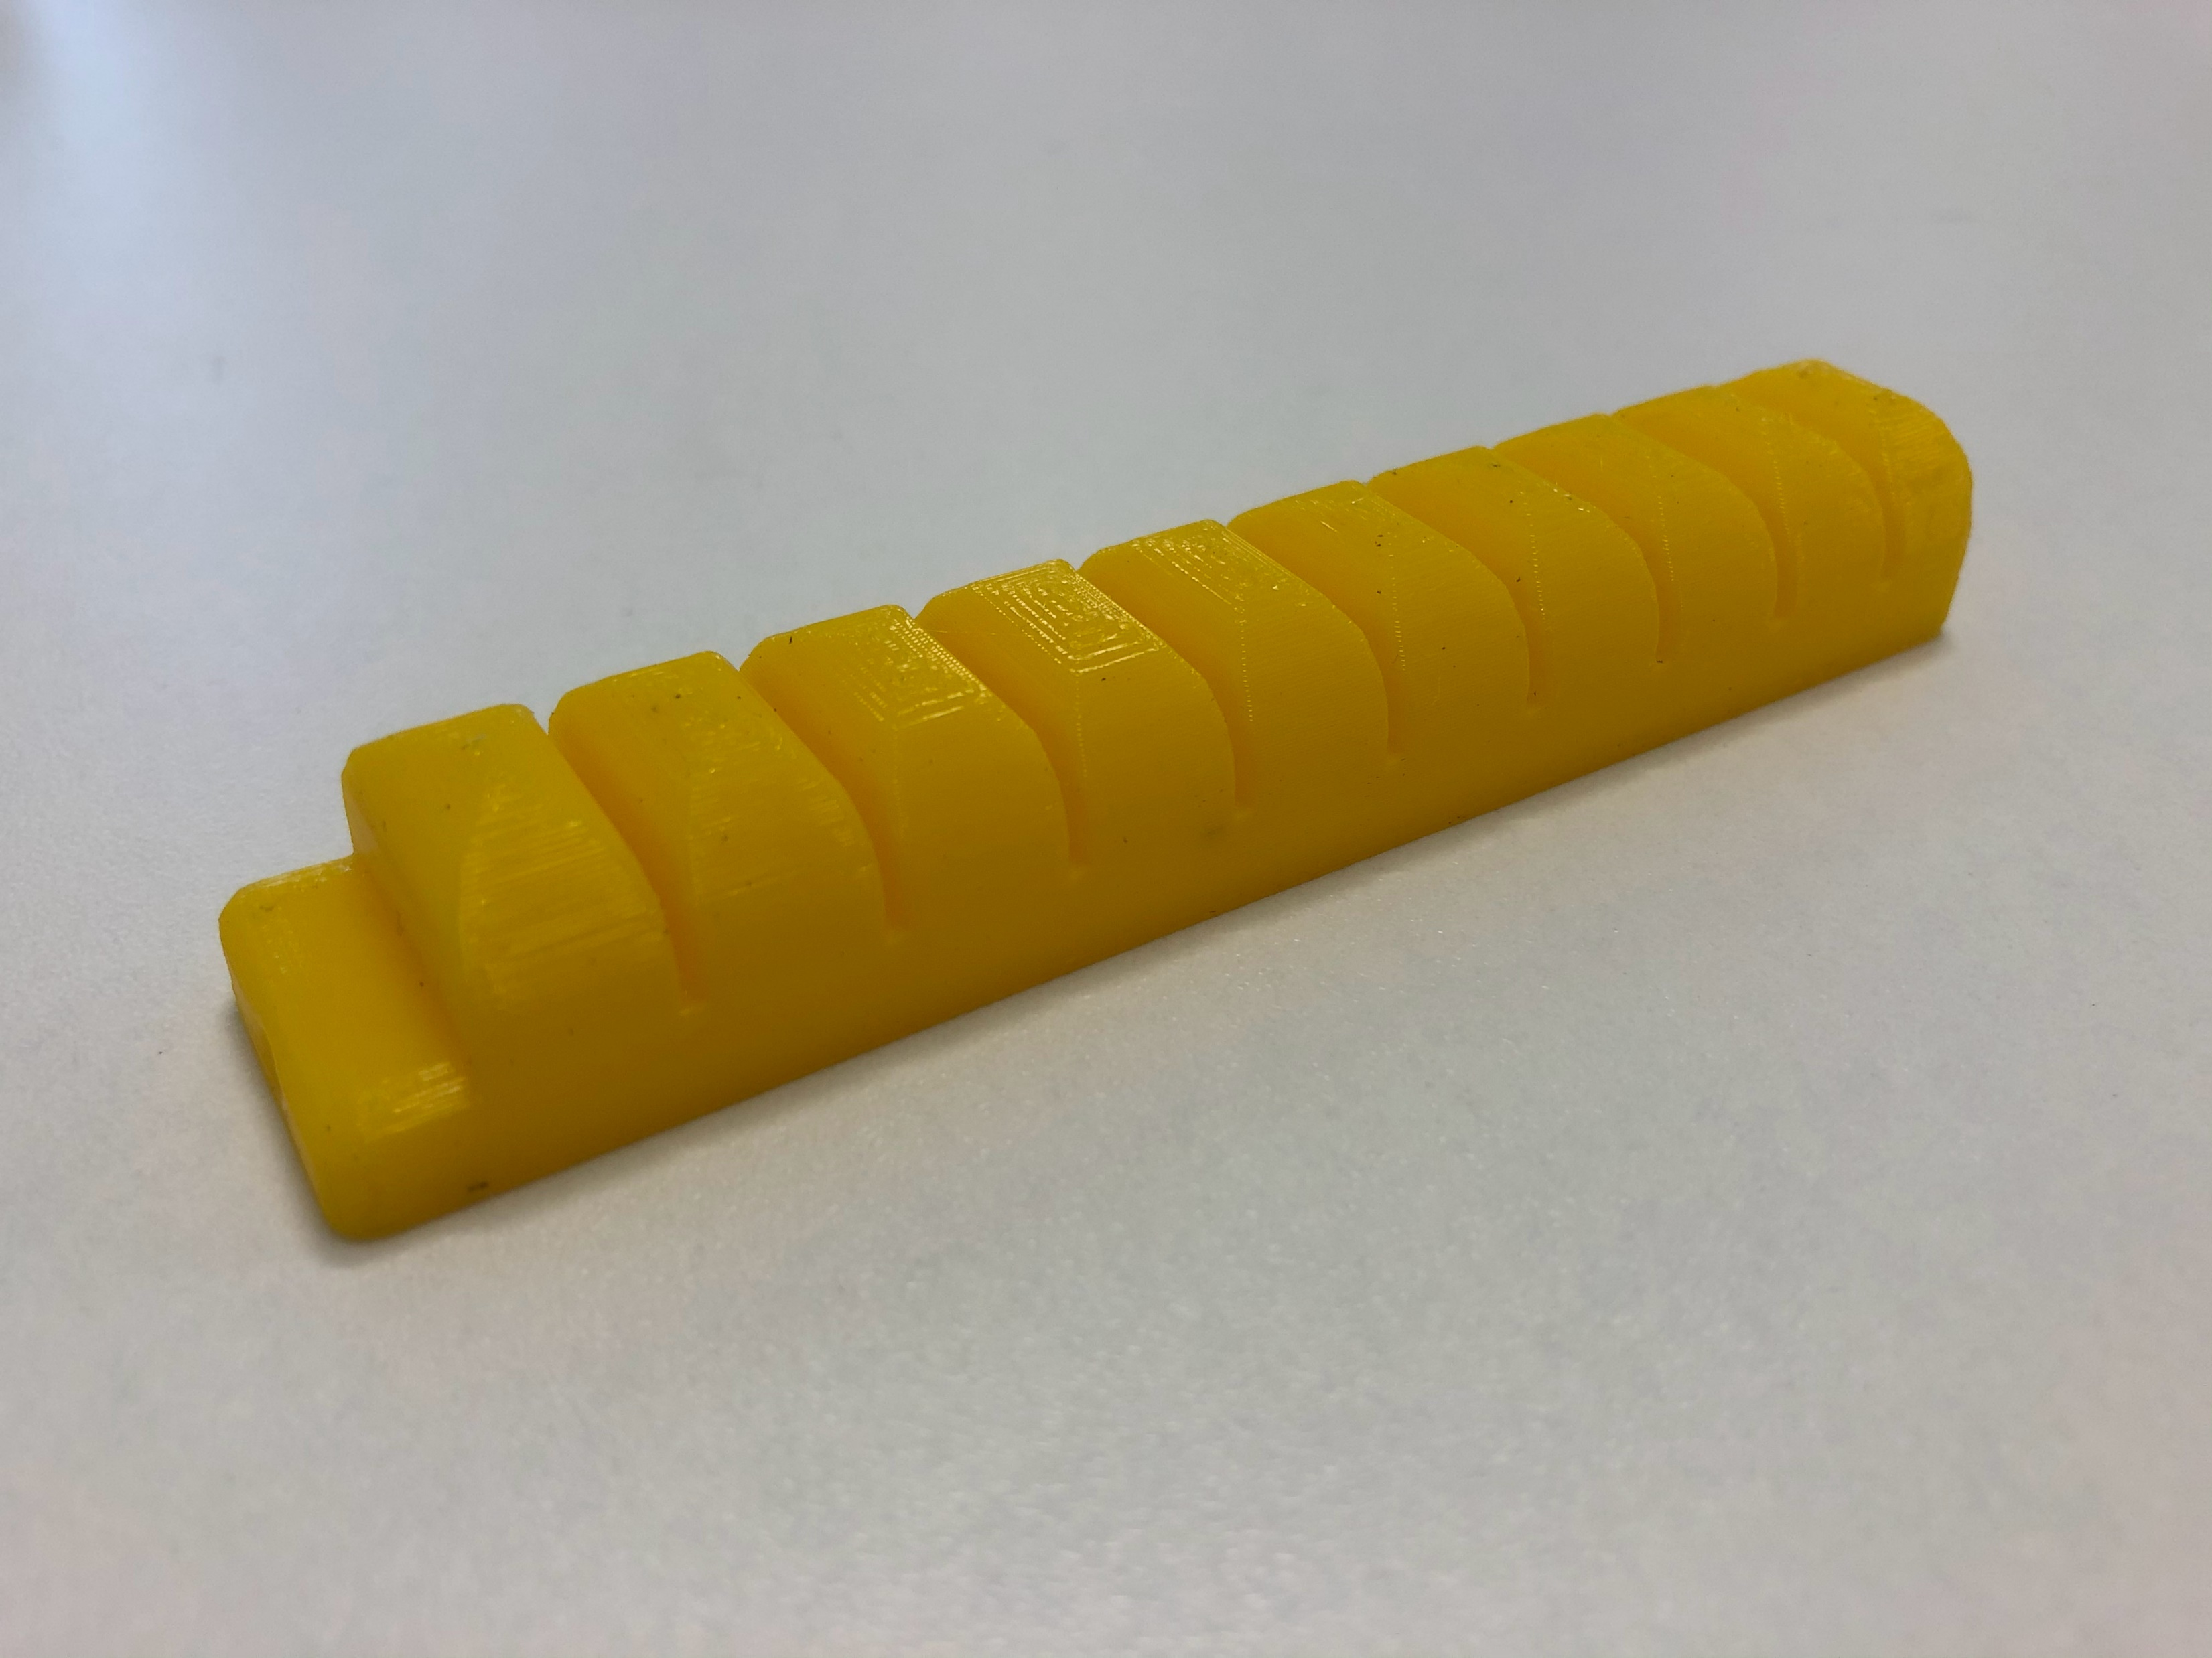
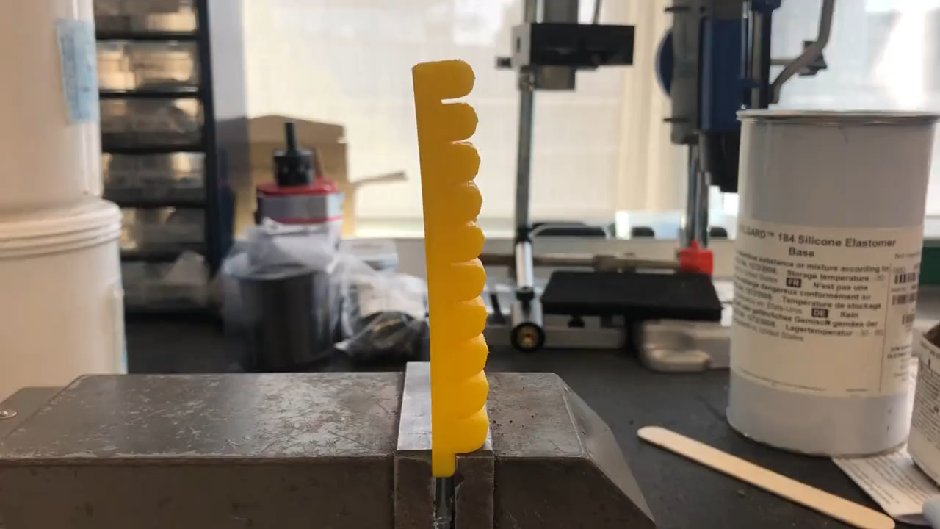
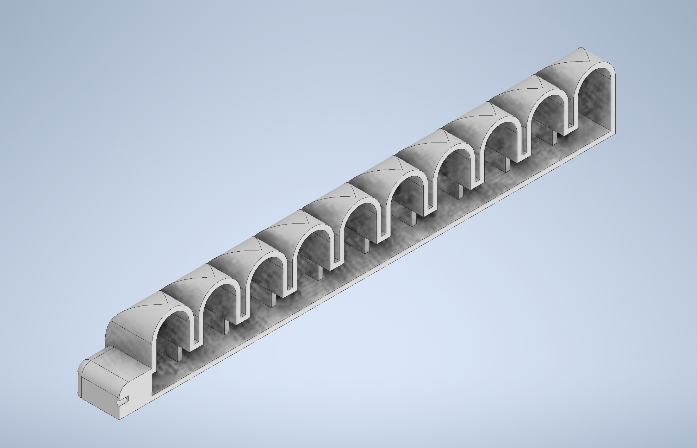
3D printed actuator with NinjaFlex filament

Slide 4
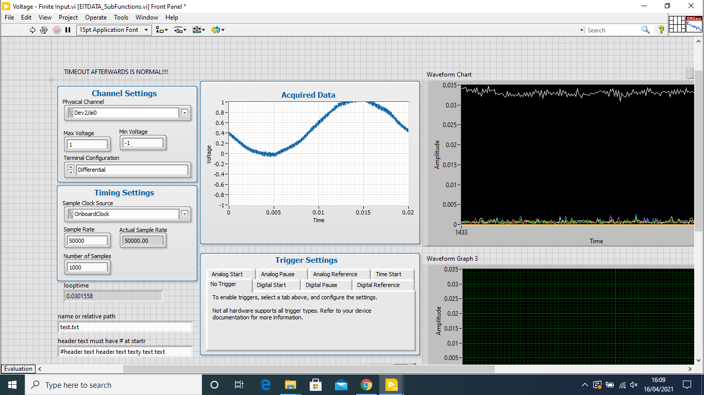
EIT hardware/software test

Slide 5
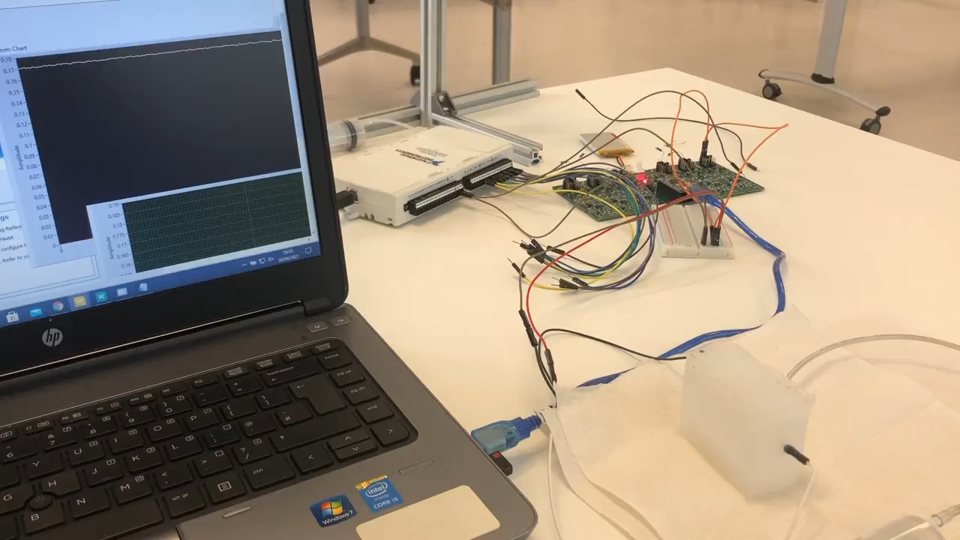
EIT hardware/software test
Voltage
Two
electrodes
Time on x-axis

